Slide 1
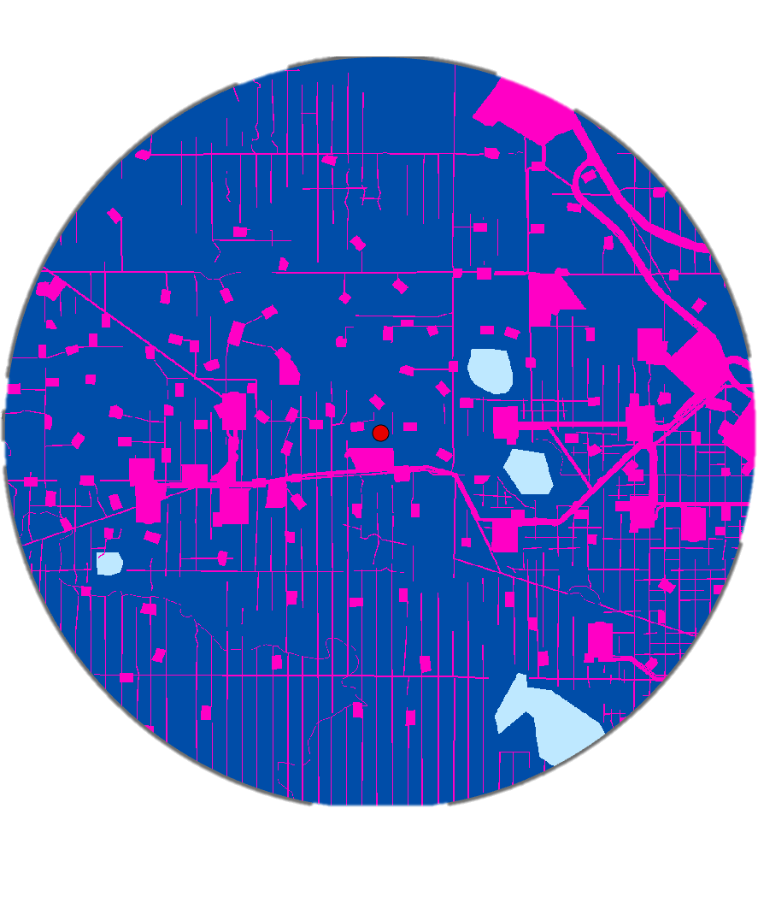
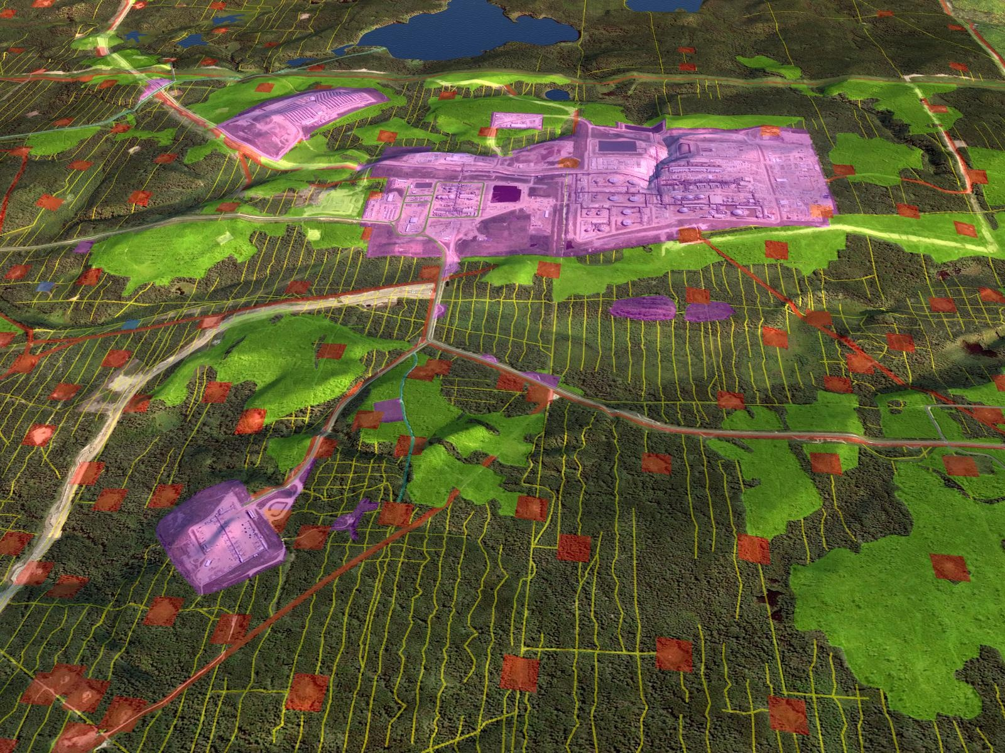
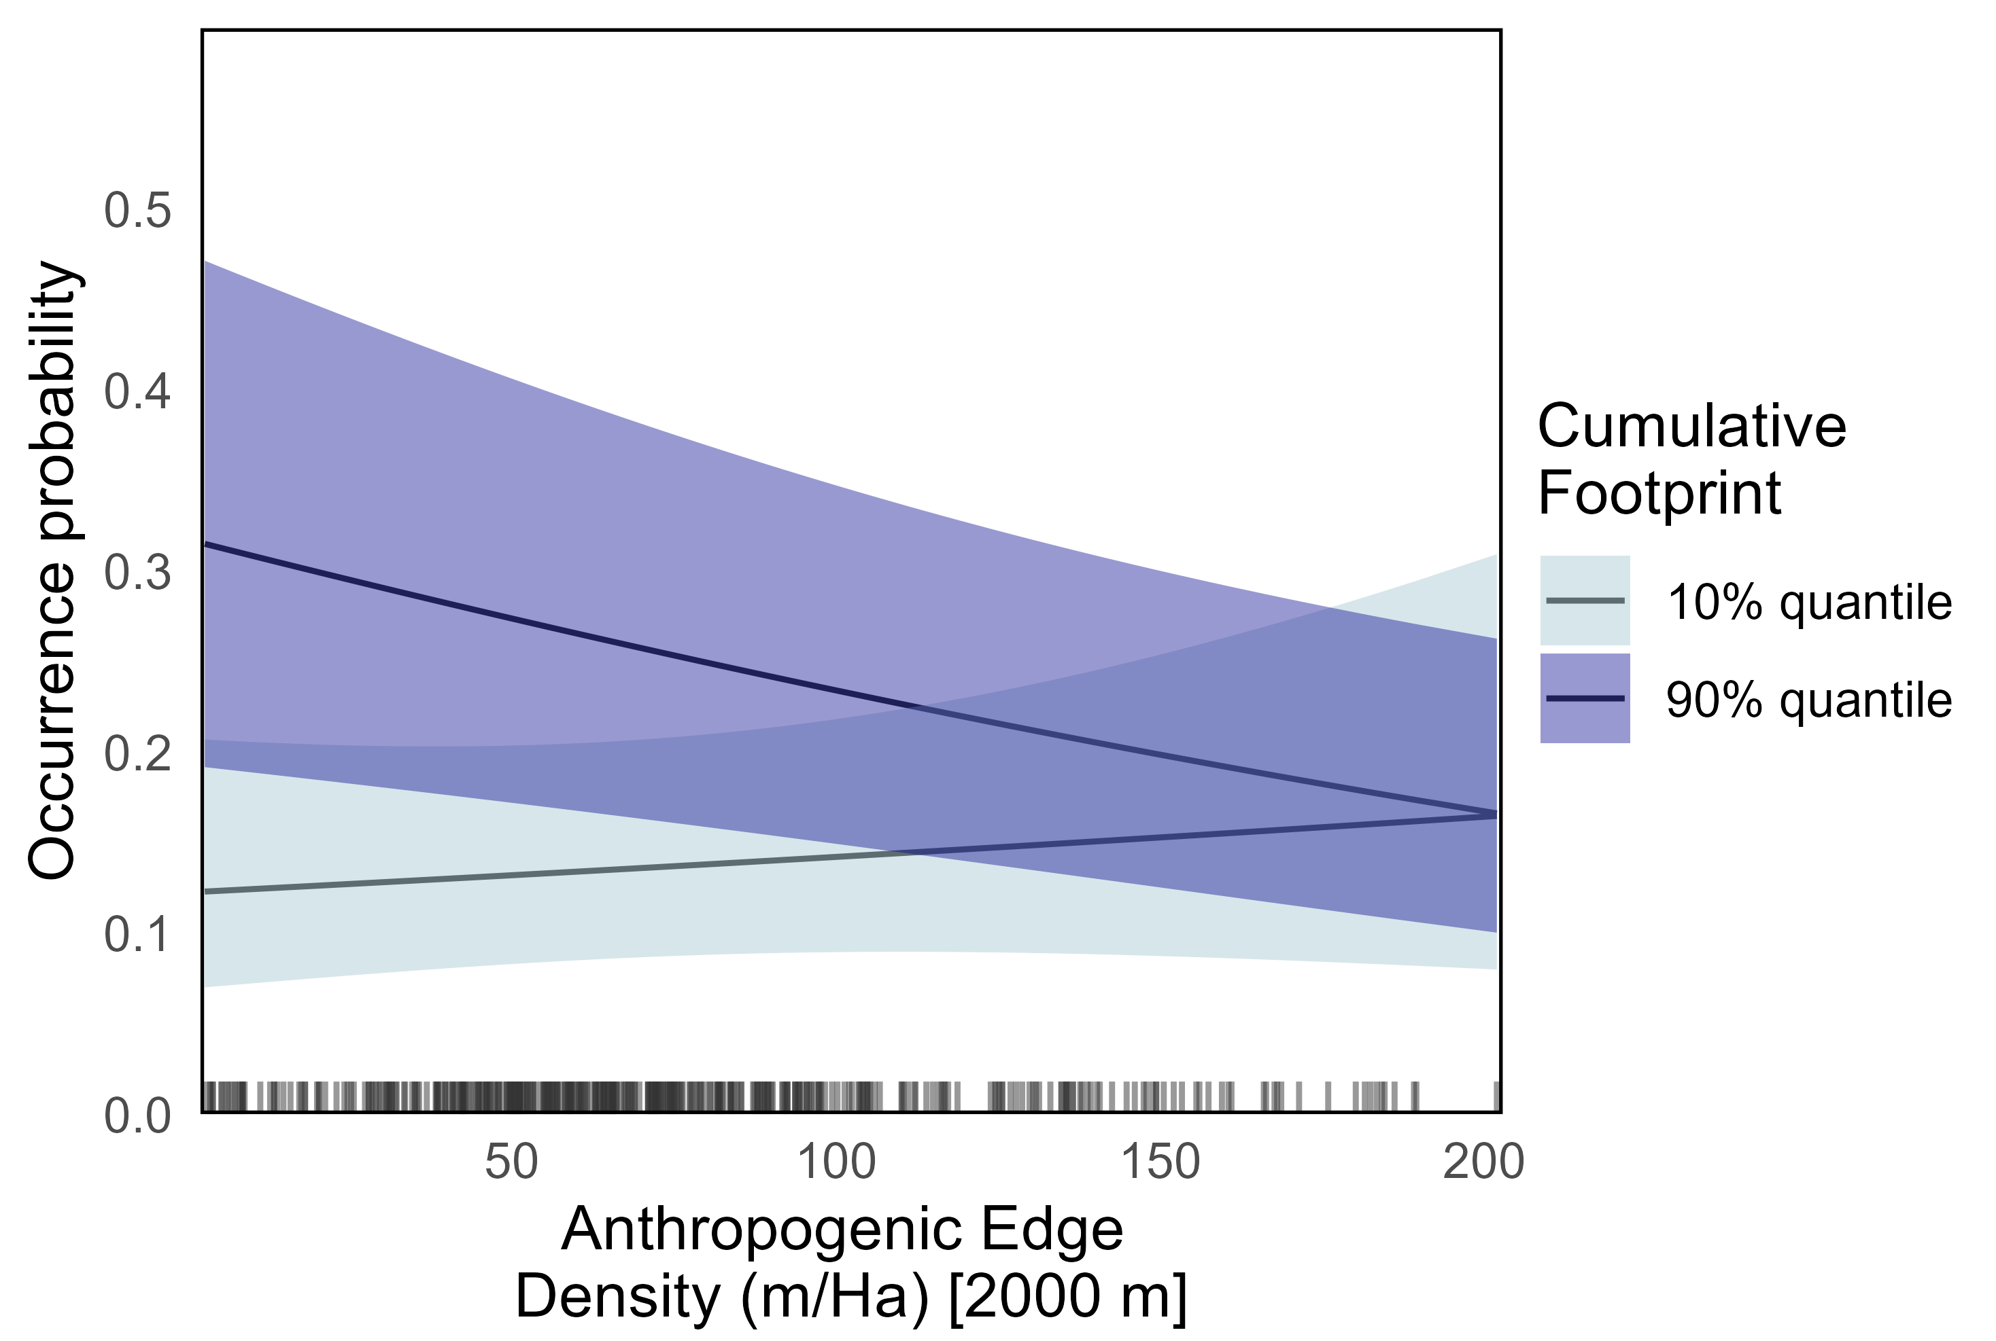
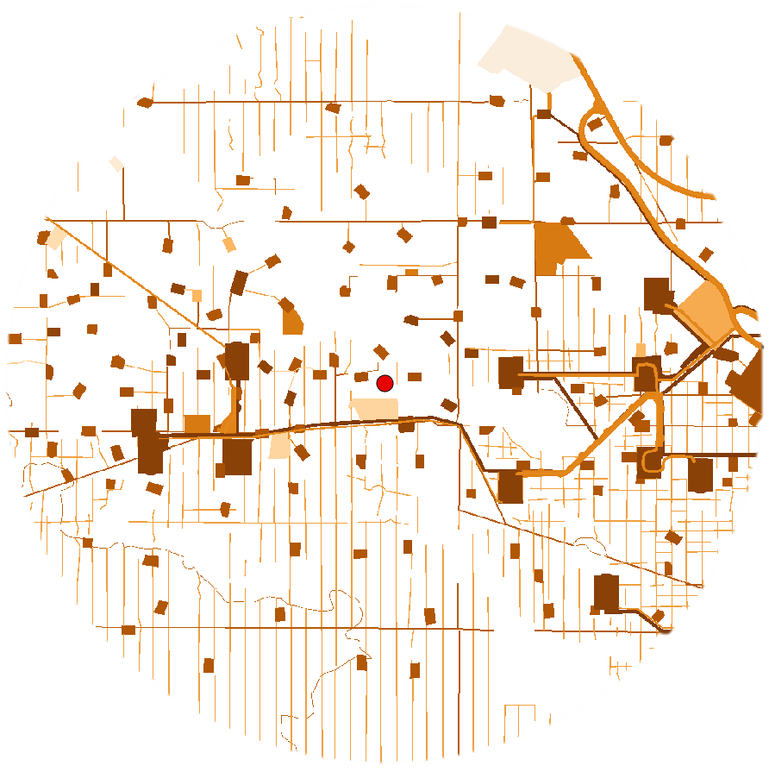
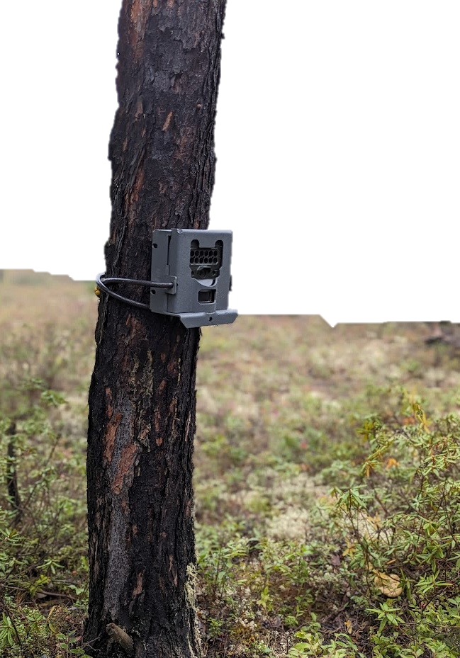
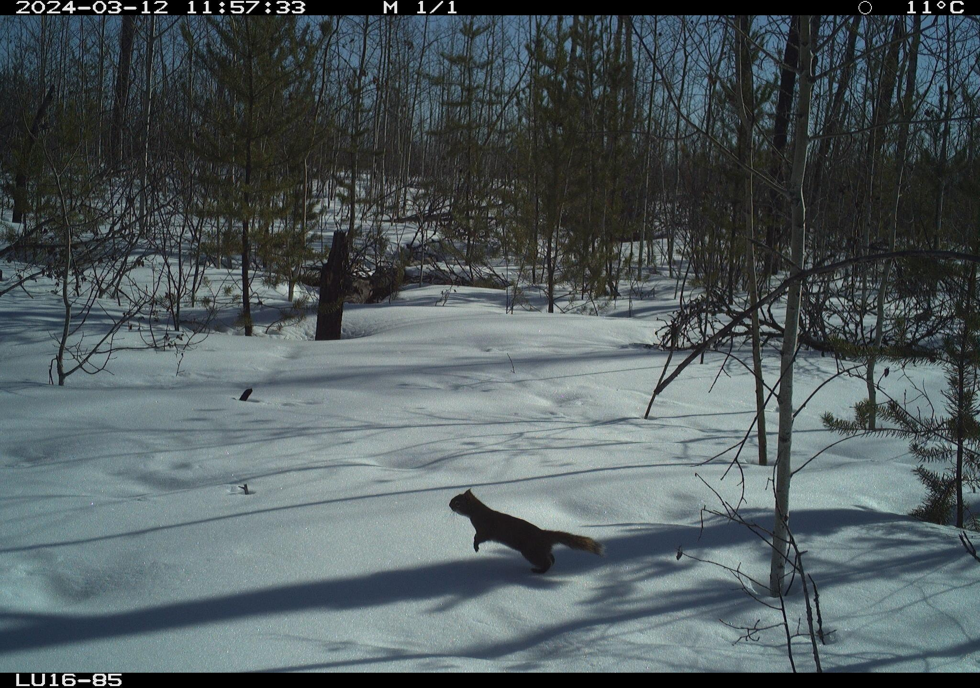
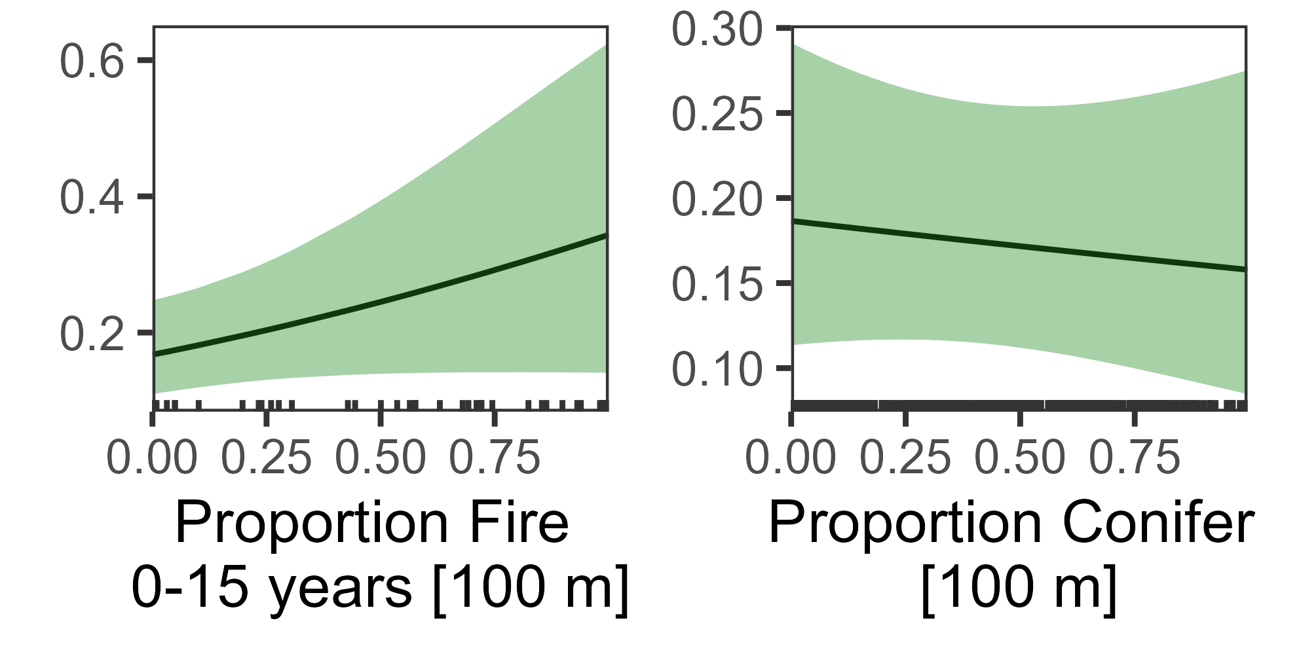
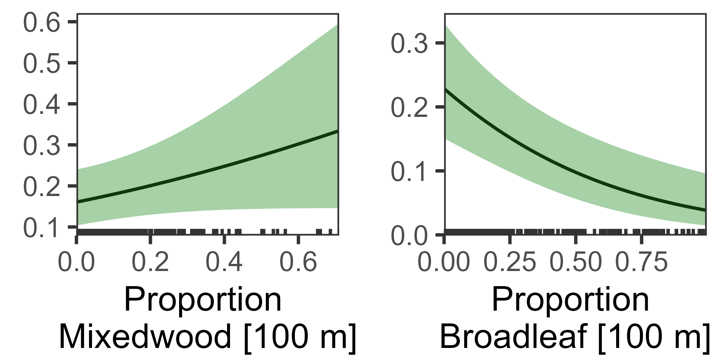
Oil & gas development changes landscape structure
Configuration
Model selection
Composition
Red squirrel occurrence measured with camera traps
Red squirrels are affected differently by industrial footprint and edge creation, likely due to:
predation (-)
resource complementation (+)

Slide 2
Oil & gas development changes landscape structure
Configuration
Model selection
Composition
Red squirrel occurrence measured with camera traps
Red squirrels are affected differently by industrial footprint and edge creation, likely due to:
predation (-)
resource complementation (+)

Slide 3
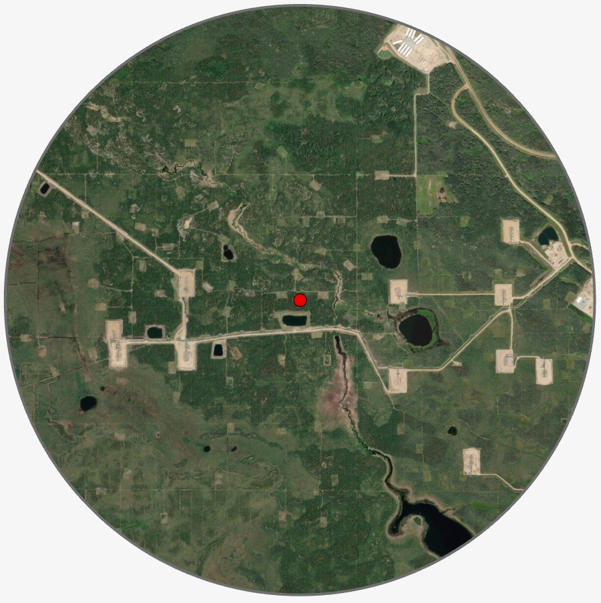
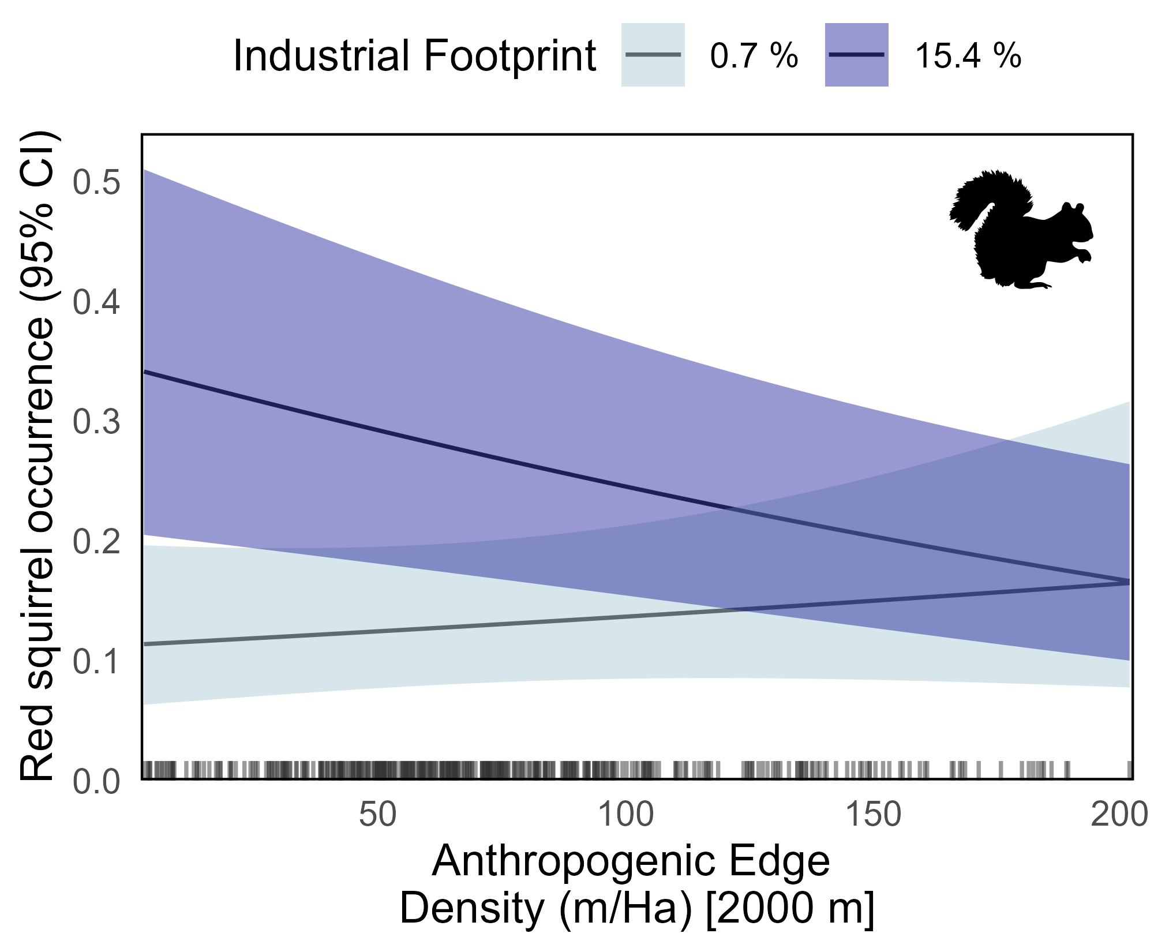

Oil & gas development changes landscape structure
Model Selection
Configuration
Composition
Red squirrel occurrence measured with camera traps
Footprint effect (+)
Edge effect (–)
Resource complementation
Predation
The negative ecological impact of edge creation is context-dependent, intensifying as the cumulative industrial footprint in the surrounding landscape increases.

